Slide 1
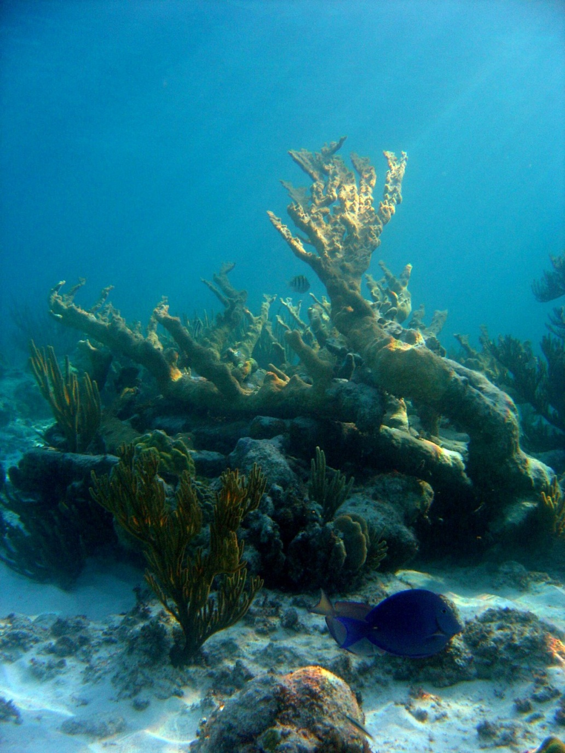
MES 503 - Research methods and tools I
Fall 2024
instructor : Lauren Olinger
Lab 2 – Descriptive Statistics, Visualizing data,
and Pivot tables
some presentation materials made by Marilyn Brandt, Andrew Heiss, and others

Slide 2
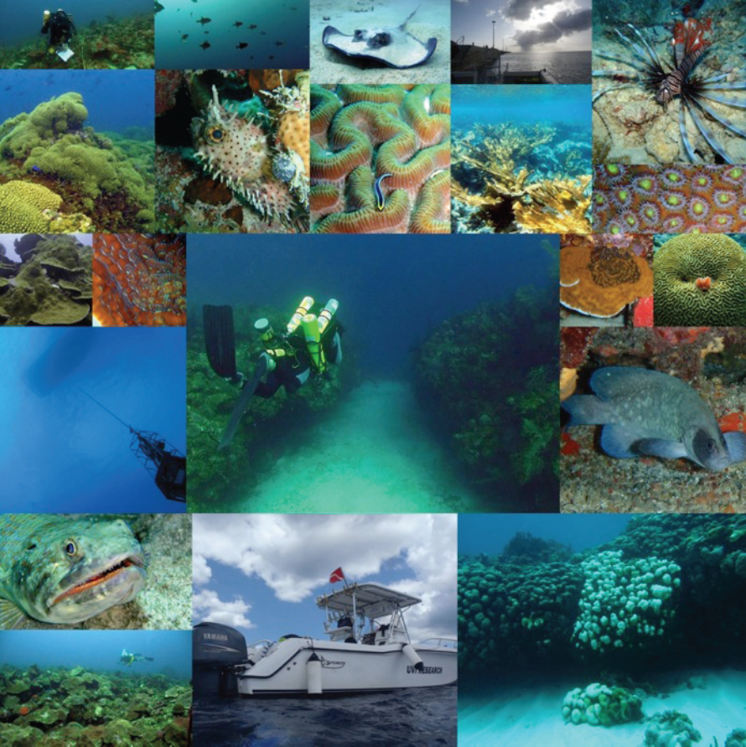
US Virgin Islands Territorial Coral Reef Monitoring Program (TCRMP) 2002-present
Uses a modified Atlantic and Gulf Rapid Reef Assessment (AGRAA) methodology
33 sites across the USVI from 3 to 65 meters depth (10’ – 220’)
Collaborative partnership between NOAA, CZM, and UVI
See: https://sites.google.com/site/usvitcrmp/

Slide 3
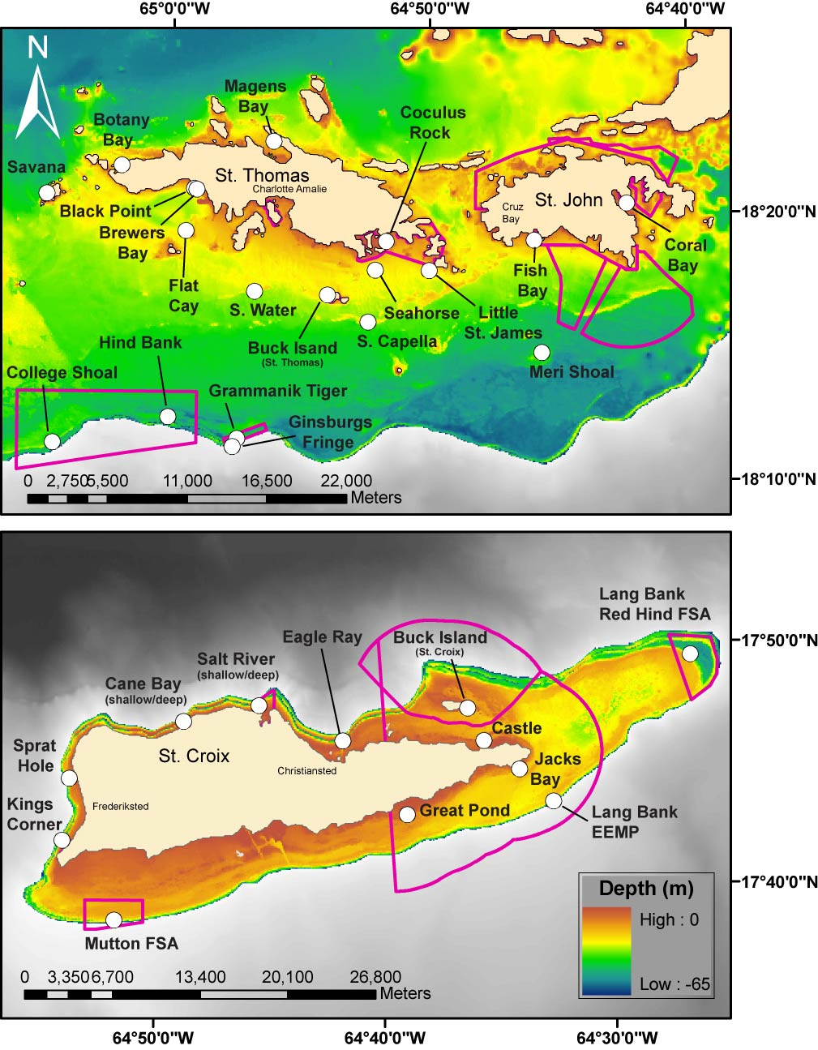
US Virgin Islands Territorial Coral Reef Monitoring Program (TCRMP) 2002-present
Benthic and fish monitoring at sites around the USVI, including:
24 Shallow-mid depth (< 30 m)
9 MCE (≥ 30 m)
Surveys performed on SCUBA

Slide 4
2017 Post-hurricane assessments at 6 TCRMP sites
Six Selected St. Thomas Sites:
Magen’s Bay Black Point
Botany Bay Buck Island (STT)
Savana Coculus Rock
More “Impacted” by shoreline development and watershed use

Slide 5
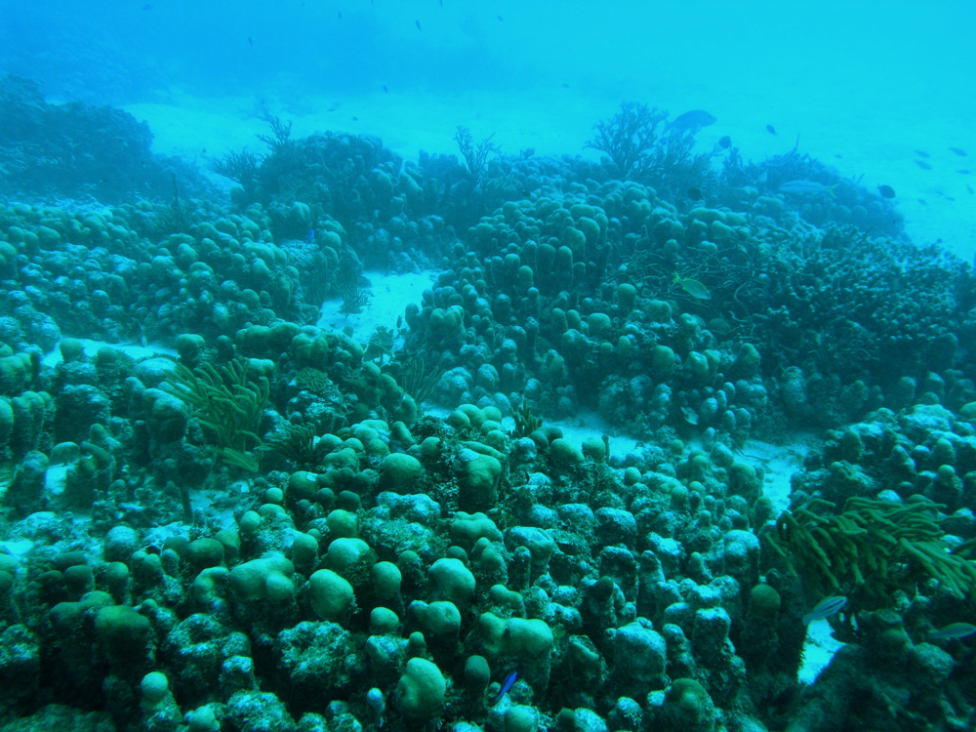
Methods: Coral Health Assessments
In situ assessment of individual coral colonies along the 6 permanent 10 m transects
All light dependent stony corals assessed that intercept the line (“line intercept method”)
start
end
10 m
T. Smith

Slide 6
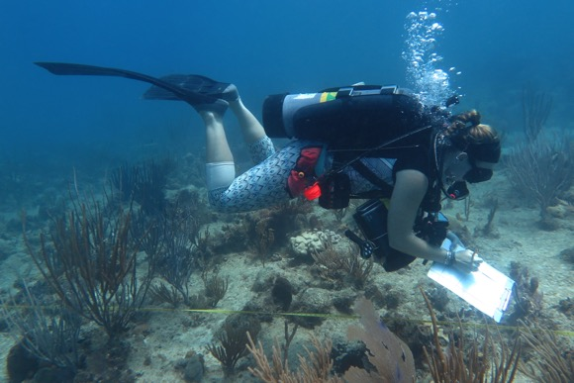
Methods: Coral Health Assessments
Corals that intercept the line are identified to species or genus, sized (length, width, height)
Assessed for:
Bleaching
Disease
Partial mortality
Interactions with other organisms
T. Smith

Slide 7
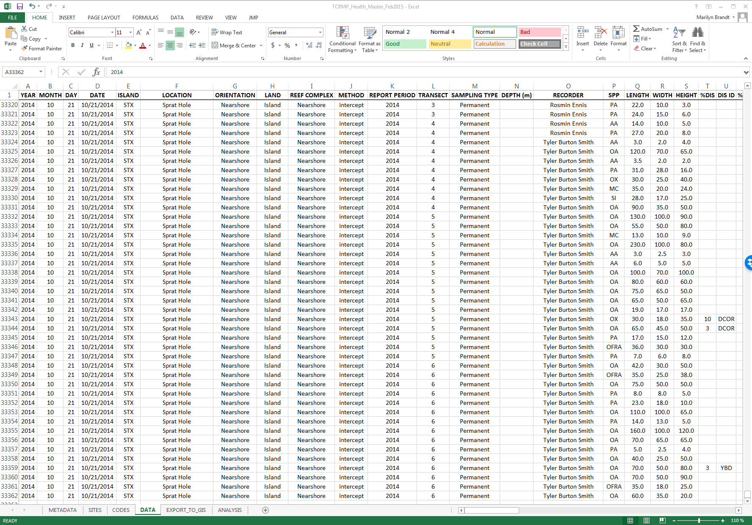
Coral health assessments database
All colonies assessed for species, size, and health information
Each row is a coral colony that was assessed

Slide 8
this weeks content
Descriptive Statistics
Visualizing data
Pivot tables

Slide 9
descriptive statistics
Why they are useful:
summarize the characteristics of our data/observations
form the initial step in a statistical analysis
information about the centrality (e.g., mean, median)
information about the variability (e.g., variance, standard deviation)

Slide 10





descriptive statistics
Mean ($\overline{y}$)
$$\overline{y}= \frac{\sum_{i=1}^{n}{y_{i}}}{n}$$
$$s^{2}= \frac{\sum_{i=1}^{n}{{(y_{i}−\overline{y})}^{2}}}{n−1}$$
Variance (s²)
$$s= \sqrt{\frac{\sum_{i=1}^{n}{{(y_{i}−\overline{y})}^{2}}}{n−1}}$$
Standard deviation (s)
Standard error of the mean (SEM)
$SEM= \frac{s}{\sqrt{n}}$

Slide 11
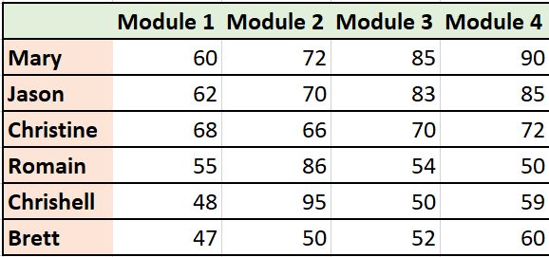


descriptive statistics
The Mean ($\overline{y}$):
Most commonly used statistic that tells us about the center of a data set.
involved in many statistical tests
The sum of all values divided by the number of observations.
= 307 / 4 = 76.75
+
+
+
= Mary’s mean score across 4 modules
$$\overline{y}= \frac{\sum_{i=1}^{n}{y_{i}}}{n}$$

Slide 12
descriptive statistics
bonus: The Median :
the middle point of your ordered data.
Example: 1,3,10,5,8
Step1: Order the observations
1,3,5,8,10
The median is the number in the middle
median=5

Slide 13
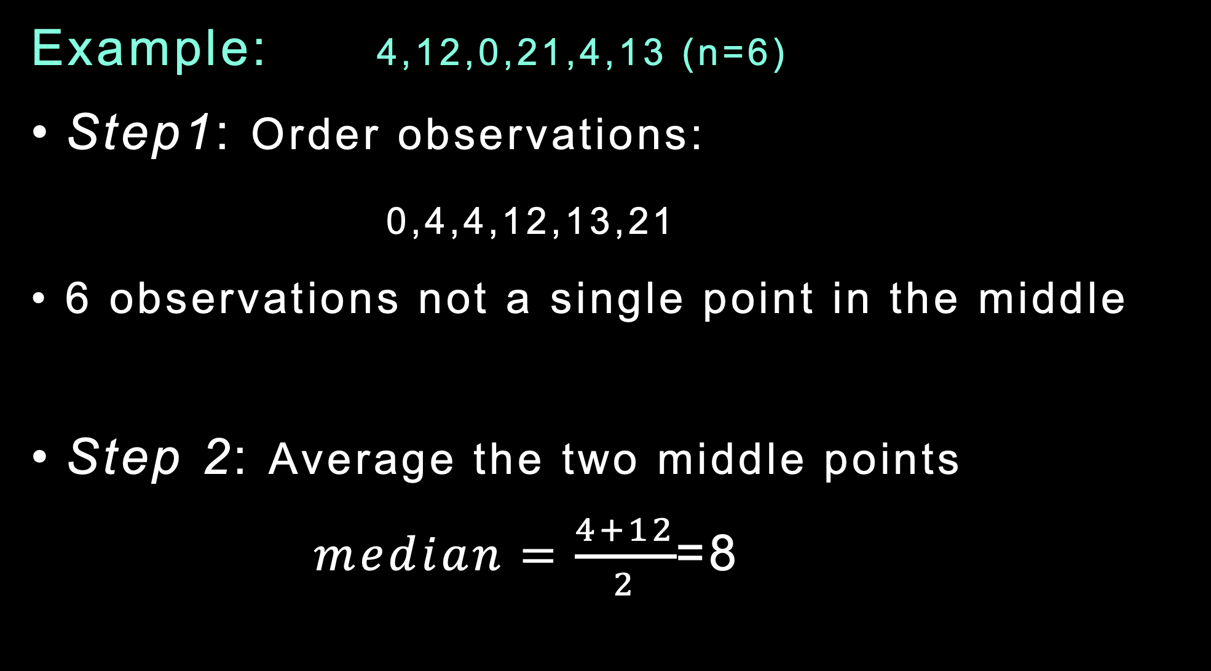
descriptive statistics
Example: 4,12,0,21,4,13 (n=6)
Step1: Order observations:
0,4,4,12,13,21
6 observations not a single point in the middle
Step 2: Average the two middle points
$median=\frac{4+12}{2}$=8

Slide 14
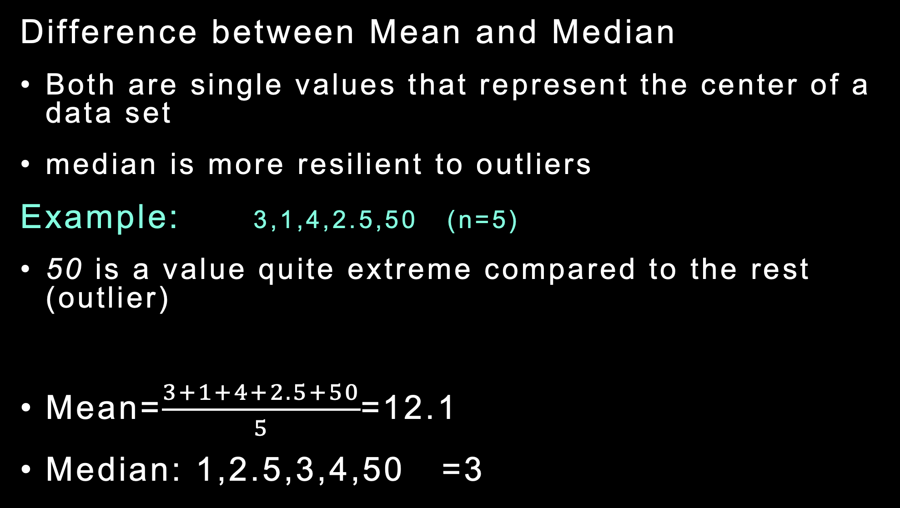
descriptive statistics
Difference between Mean and Median
Both are single values that represent the center of a data set
median is more resilient to outliers
Example: 3,1,4,2.5,50 (n=5)
50 is a value quite extreme compared to the rest (outlier)
Mean=$\frac{3+1+4+2.5+50}{5}$=12.1
Median: 1,2.5,3,4,50 =3

Slide 15
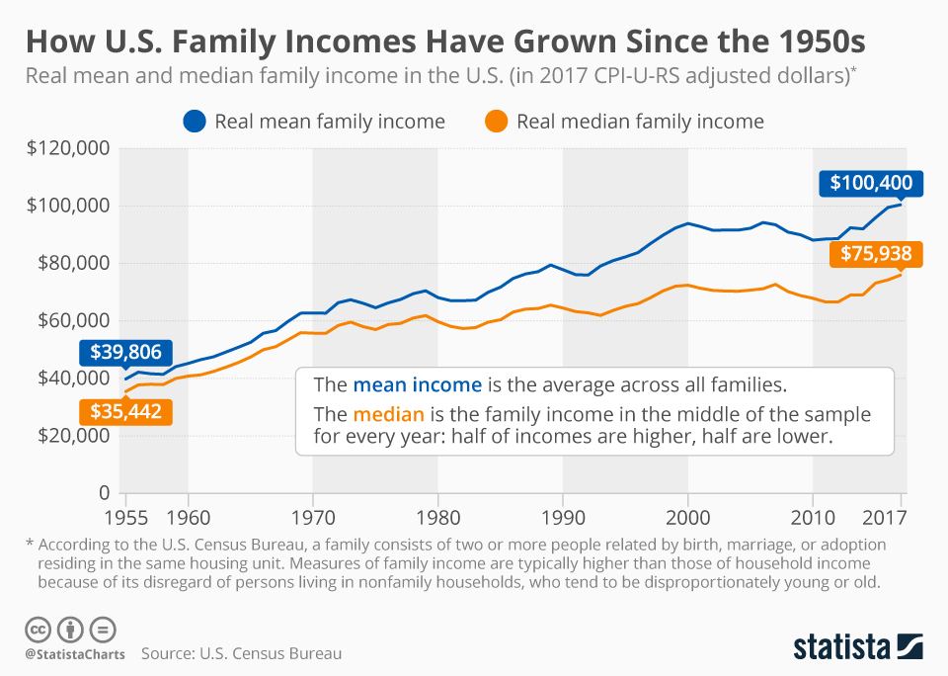
descriptive statistics

Slide 16
descriptive statistics
Mean ($\overline{y}$)
$$\overline{y}= \frac{\sum_{i=1}^{n}{y_{i}}}{n}$$
$$s^{2}= \frac{\sum_{i=1}^{n}{{(y_{i}−\overline{y})}^{2}}}{n−1}$$
Variance (s²)
$$s= \sqrt{\frac{\sum_{i=1}^{n}{{(y_{i}−\overline{y})}^{2}}}{n−1}}$$
Standard deviation (s)
Standard error of the mean (SEM)
$SEM= \frac{s}{\sqrt{n}}$

Slide 17


descriptive statistics
The Variance ($s^{2}$ )
A measure to show how spread out our observations are
The average of the squared differences from the mean.
$$s^{2}= \frac{\sum_{i=1}^{n}{{(y_{i}−\overline{y})}^{2}}}{n−1}$$

Slide 18
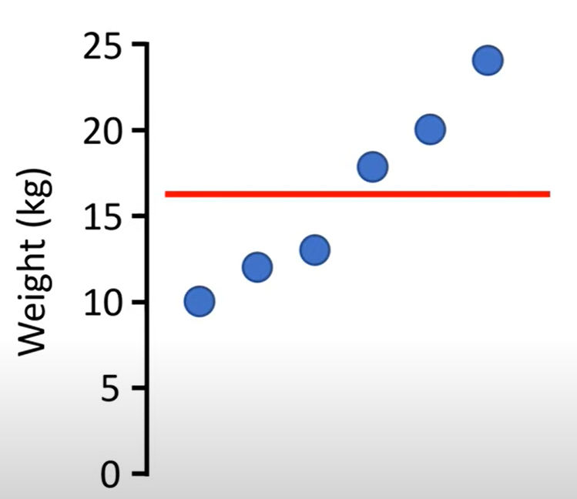

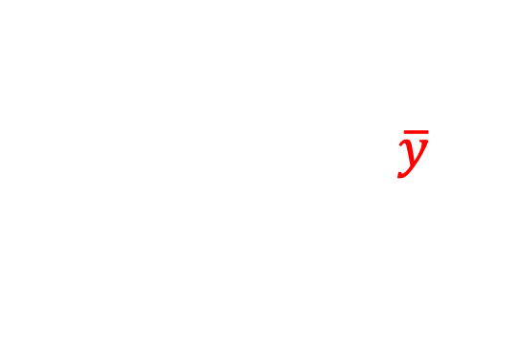
descriptive statistics
The Variance ($s^{2}$ )
A measure to show how spread out our observations are
The average of the squared differences from the mean.
Dog 1: 10kg
Dog 2: 12kg
Dog 3: 13kg
Dog 4: 17kg
Dog 5: 20kg
Dog 6: 24kg
$$s^{2}= \frac{\sum_{i=1}^{n}{{(y_{i}−\overline{y})}^{2}}}{n−1}$$
Mean = 16kg

Slide 19

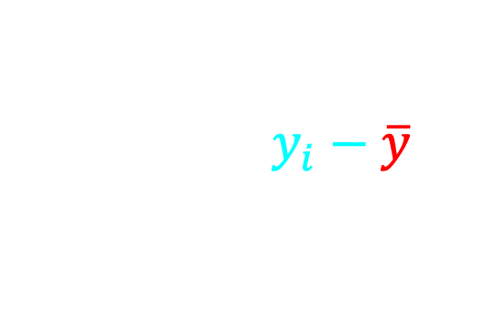
descriptive statistics
The Variance ($s^{2}$ )
A measure to show how spread out our observations are
The average of the squared differences from the mean.
Dog 1: 10kg
Dog 2: 12kg
Dog 3: 13kg
Dog 4: 17kg
Dog 5: 20kg
Dog 6: 24kg
-6
-4
-3
1
4
8
$$s^{2}= \frac{\sum_{i=1}^{n}{{(y_{i}−\overline{y})}^{2}}}{n−1}$$
Mean = 16kg

Slide 20
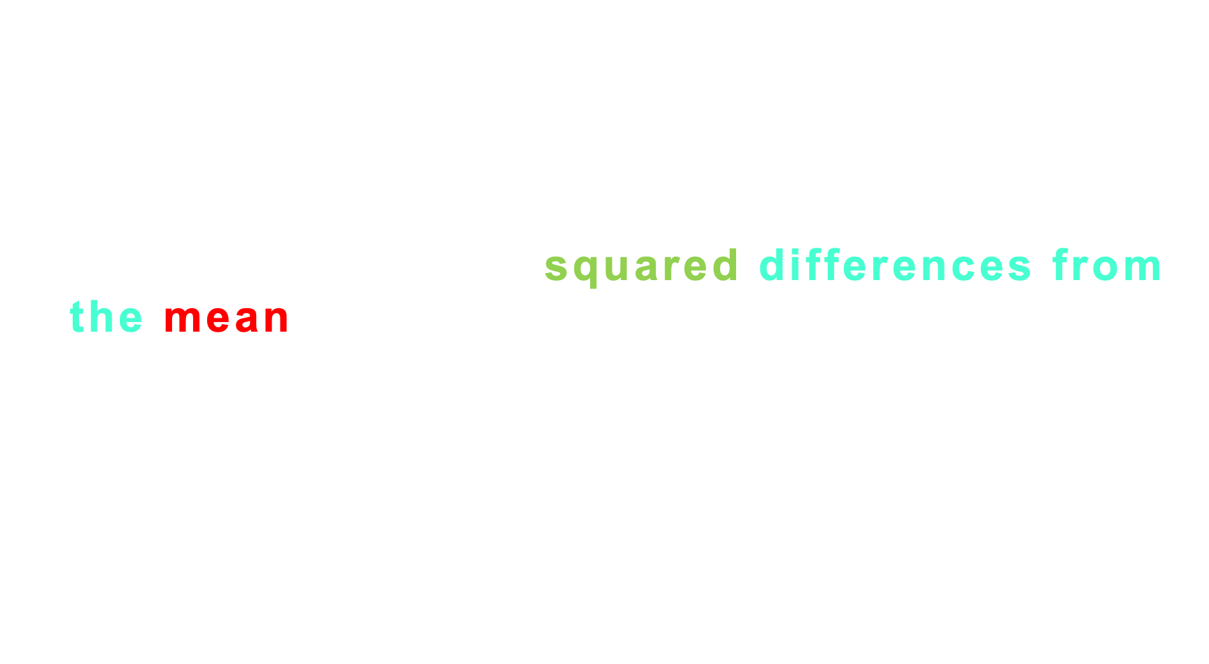
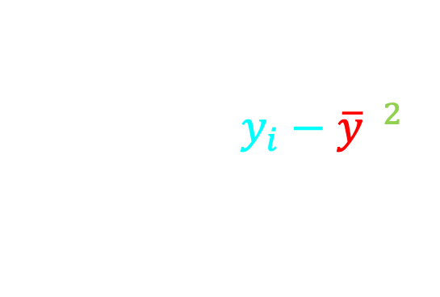
descriptive statistics
The Variance ($s^{2}$ )
A measure to show how spread out our observations are
The average of the squared differences from the mean.
Dog 1: 10kg
Dog 2: 12kg
Dog 3: 13kg
Dog 4: 17kg
Dog 5: 20kg
Dog 6: 24kg
-6
-4
-3
1
4
8
$$s^{2}= \frac{\sum_{i=1}^{n}{{(y_{i}−\overline{y})}^{2}}}{n−1}$$
36
16
9
1
16
64
Mean = 16kg

Slide 21
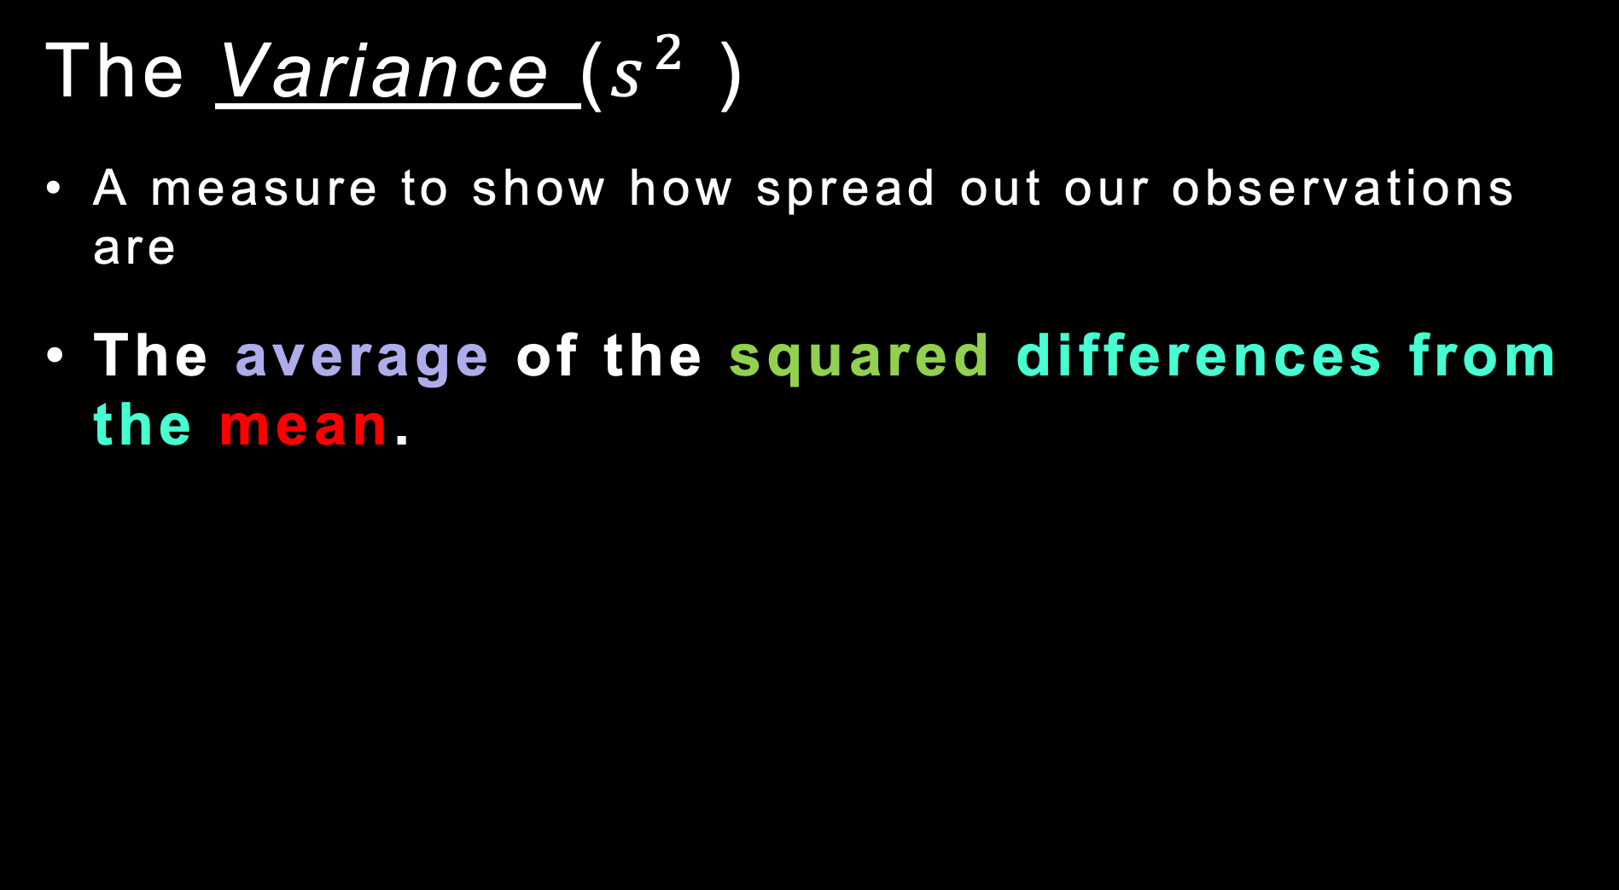
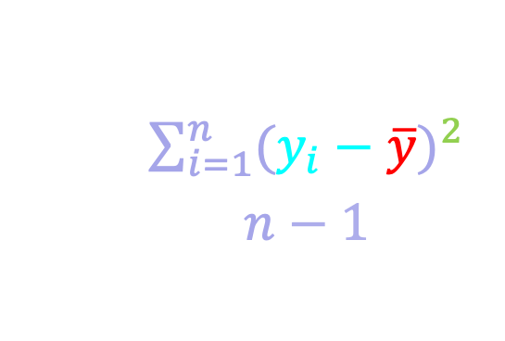
descriptive statistics
The Variance ($s^{2}$ )
A measure to show how spread out our observations are
The average of the squared differences from the mean.
Dog 1: 10kg
Dog 2: 12kg
Dog 3: 13kg
Dog 4: 17kg
Dog 5: 20kg
Dog 6: 24kg
-6
-4
-3
1
4
8
36
16
9
1
16
64
$$s^{2}= \frac{\sum_{i=1}^{n}{{(y_{i}−\overline{y})}^{2}}}{n−1}$$
Mean = 16kg
142 / 6 = 23.6

Slide 22
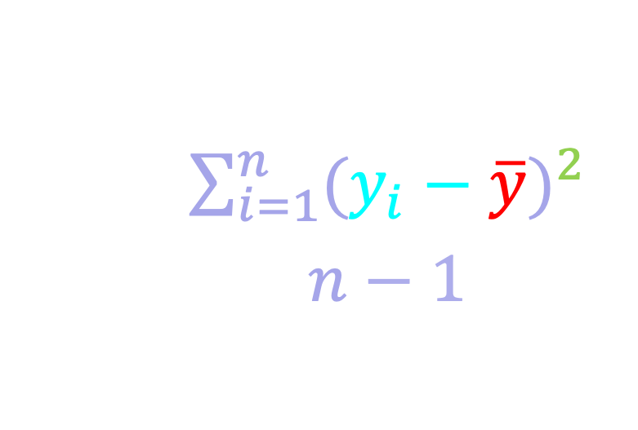
descriptive statistics
The Variance ($s^{2}$ )
A measure to show how spread out our observations are
The average of the squared differences from the mean.
Dog 1: 10kg
Dog 2: 12kg
Dog 3: 13kg
Dog 4: 17kg
Dog 5: 20kg
Dog 6: 24kg
-6
-4
-3
1
4
8
36
16
9
1
16
64
$$s^{2}= \frac{\sum_{i=1}^{n}{{(y_{i}−\overline{y})}^{2}}}{n−1}$$

Slide 23
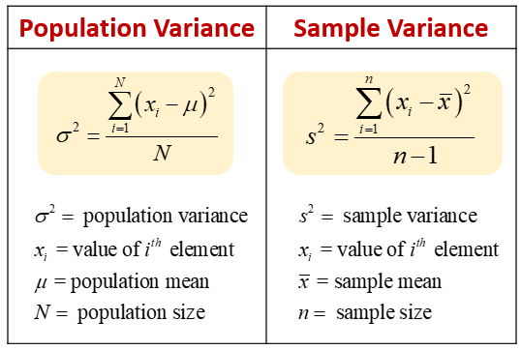

descriptive statistics
The Variance ($s^{2}$ )
A measure to show how spread out our observations are
The average of the squared differences from the mean.
Dog 1: 10kg
Dog 2: 12kg
Dog 3: 13kg
Dog 4: 17kg
Dog 5: 20kg
Dog 6: 24kg
-6
-4
-3
1
4
8
36
16
9
1
16
64
$$s^{2}= \frac{\sum_{i=1}^{n}{{(y_{i}−\overline{y})}^{2}}}{n−1}$$
142 / 5 = 28.4
read more about population parameters and sample statistics in the lab manual

Slide 24
descriptive statistics
The Variance ($s^{2}$ )
A measure to show how spread out our observations are
The average of the squared differences from the mean.
Dog 1: 10kg
Dog 2: 12kg
Dog 3: 13kg
Dog 4: 17kg
Dog 5: 20kg
Dog 6: 24kg
-6
-4
-3
1
4
8
36
16
9
1
16
64
$$s^{2}= \frac{\sum_{i=1}^{n}{{(y_{i}−\overline{y})}^{2}}}{n−1}$$
Mean = 16kg
142 / 5 = 28.4

Slide 25
descriptive statistics
Mean ($\overline{y}$)
$$\overline{y}= \frac{\sum_{i=1}^{n}{y_{i}}}{n}$$
$$s^{2}= \frac{\sum_{i=1}^{n}{{(y_{i}−\overline{y})}^{2}}}{n−1}$$
Variance (s²)
$$s= \sqrt{\frac{\sum_{i=1}^{n}{{(y_{i}−\overline{y})}^{2}}}{n−1}}$$
Standard deviation (s)
Standard error of the mean (SEM)
$SEM= \frac{s}{\sqrt{n}}$

Slide 26


descriptive statistics
The Standard deviation (s) :
It is the square root of variance
The result is in the same measurement units as our data (e.g., kg).
This makes it easier to interpret and understand the spread of the data than variance alone.
$$s= \sqrt{\frac{\sum_{i=1}^{n}{{(y_{i}−\overline{y})}^{2}}}{n−1}}$$

Slide 27
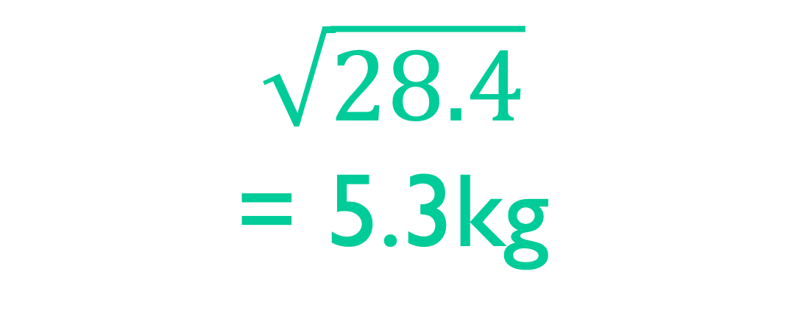
descriptive statistics
The Standard deviation (s) :
$$\sqrt{28.4}$$
= 5.3kg
$$s= \sqrt{\frac{\sum_{i=1}^{n}{{(y_{i}−\overline{y})}^{2}}}{n−1}}$$

Slide 28
descriptive statistics
The Standard deviation (s) :
Often plotted as error bars above and below the mean (5.3kg in our example).
$$s= \sqrt{\frac{\sum_{i=1}^{n}{{(y_{i}−\overline{y})}^{2}}}{n−1}}$$

Slide 29
descriptive statistics
Mean ($\overline{y}$)
$$\overline{y}= \frac{\sum_{i=1}^{n}{y_{i}}}{n}$$
$$s^{2}= \frac{\sum_{i=1}^{n}{{(y_{i}−\overline{y})}^{2}}}{n−1}$$
Variance (s²)
$$s= \sqrt{\frac{\sum_{i=1}^{n}{{(y_{i}−\overline{y})}^{2}}}{n−1}}$$
Standard deviation (s)
Standard error of the mean (SEM)
$SEM= \frac{s}{\sqrt{n}}$

Slide 30

descriptive statistics
The Standard error of the mean (SEM):
The SEM describes how much the sample mean is expected to vary from the true population mean.
Provides an estimate of how accurate the sample mean is as a representation of the true population mean.
what happens to SEM as n increases?
$SEM= \frac{s}{\sqrt{n}}$

Slide 31
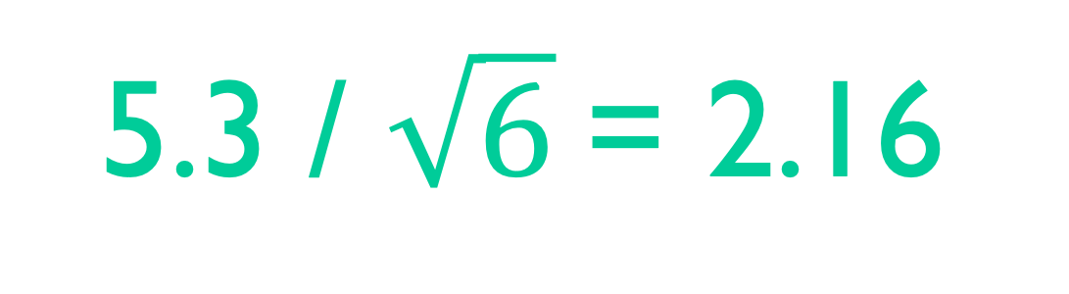
descriptive statistics
The Standard error of the mean (SEM):
5.3 / $\sqrt{6}$= 2.16
$SEM= \frac{s}{\sqrt{n}}$

Slide 32

visualizing data
https://r4ds.had.co.nz/introduction.html

Slide 33
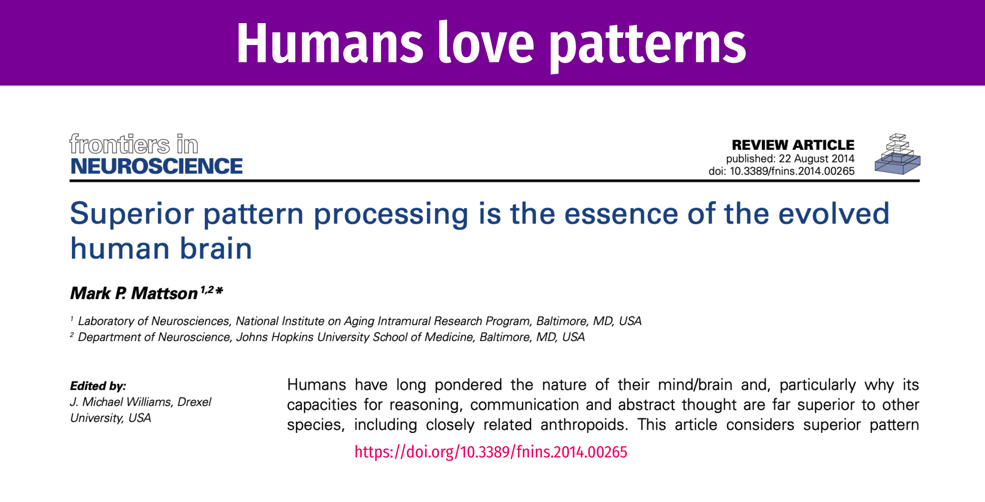
visualizing data
https://datavizf23.classes.andrewheiss.com/slides/01-slides.pdf

Slide 34
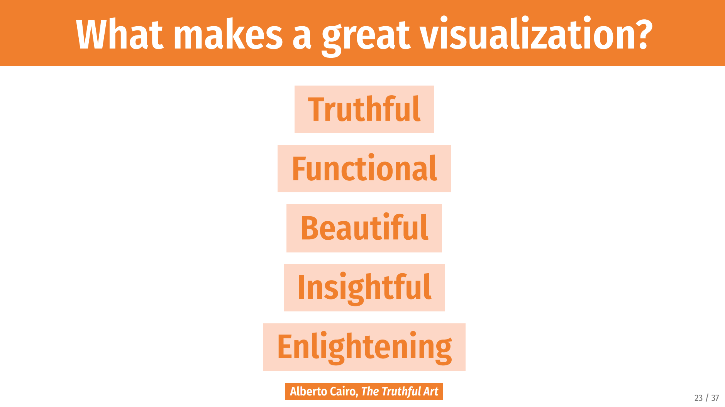
https://datavizf23.classes.andrewheiss.com/slides/01-slides.pdf

Slide 35
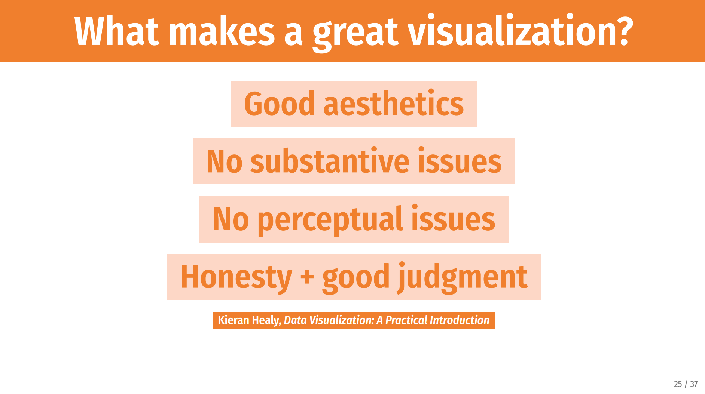
https://datavizf23.classes.andrewheiss.com/slides/01-slides.pdf

Slide 36
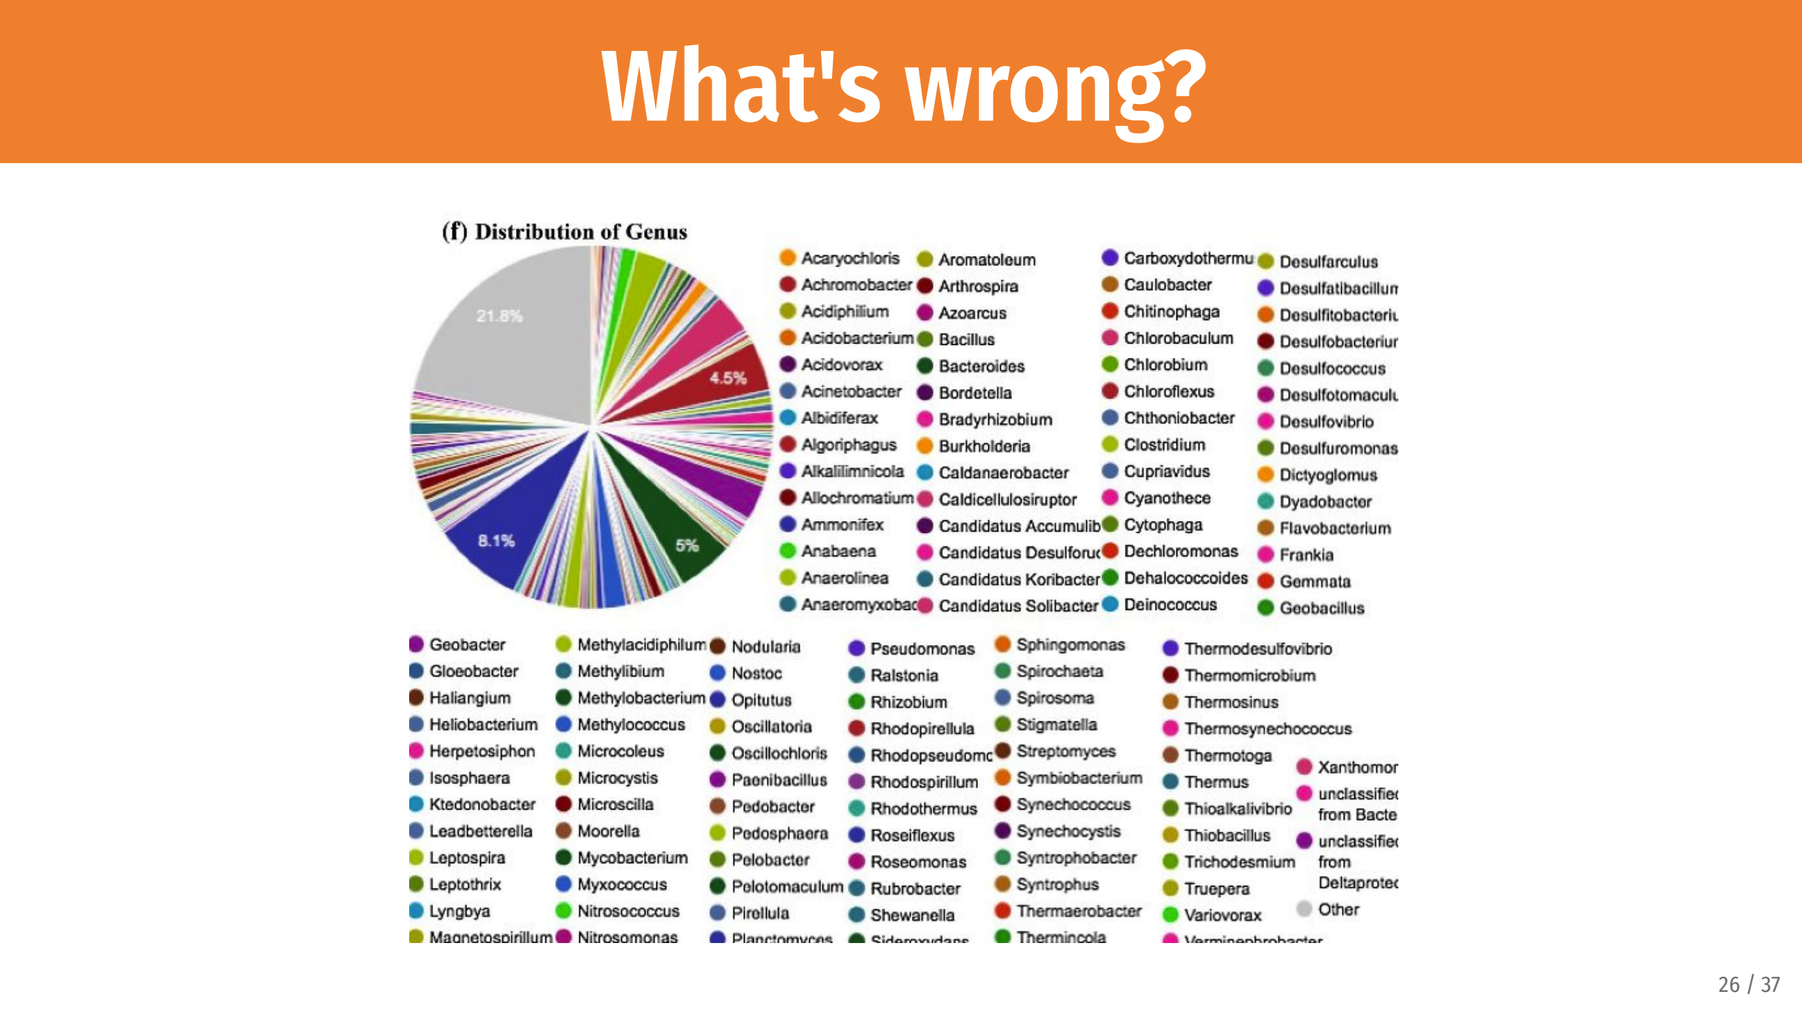
https://datavizf23.classes.andrewheiss.com/slides/01-slides.pdf

Slide 37
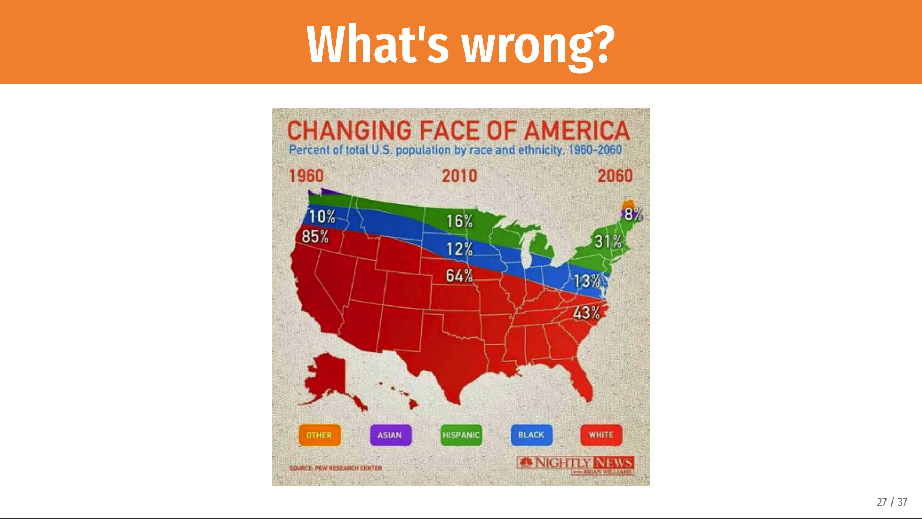
https://datavizf23.classes.andrewheiss.com/slides/01-slides.pdf

Slide 38
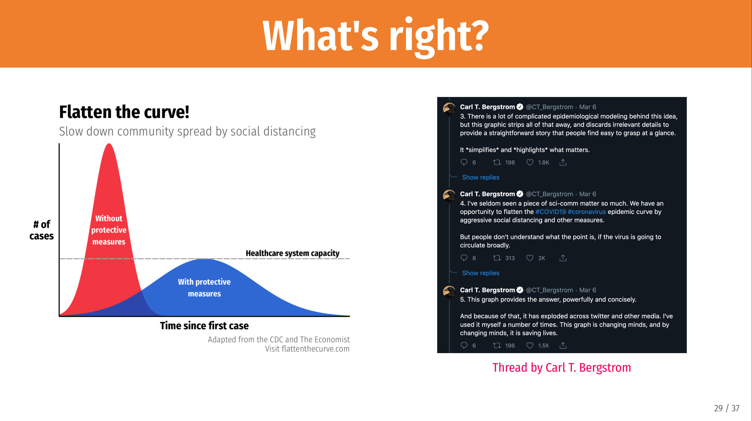
https://datavizf23.classes.andrewheiss.com/slides/01-slides.pdf

Slide 39
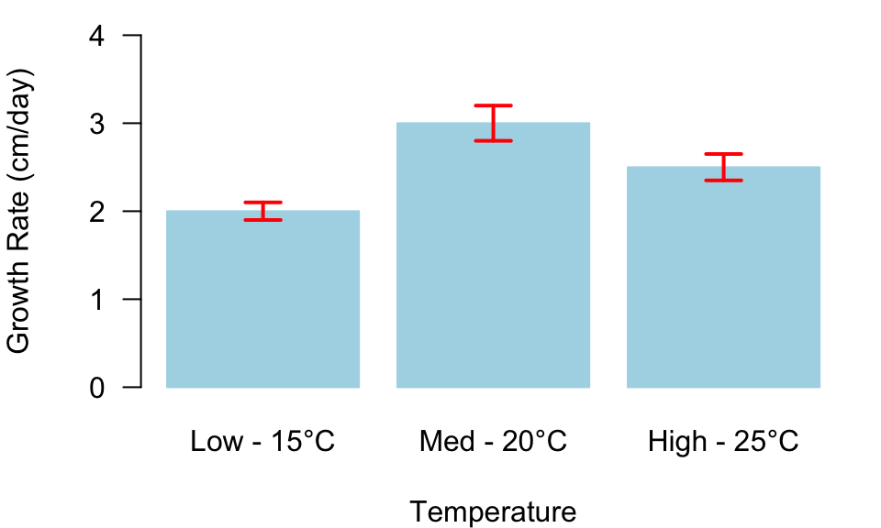
Plot requirements
Every plot must have:
Axis Labels with Units
Axis Values
Data Source/Caption/Title
other important things to include
Legend
Consistent Color Scheme
Grid Lines
Error Bars
Figure 9.1: Average growth rate of organism under different temperatures ± SEM.

Slide 40
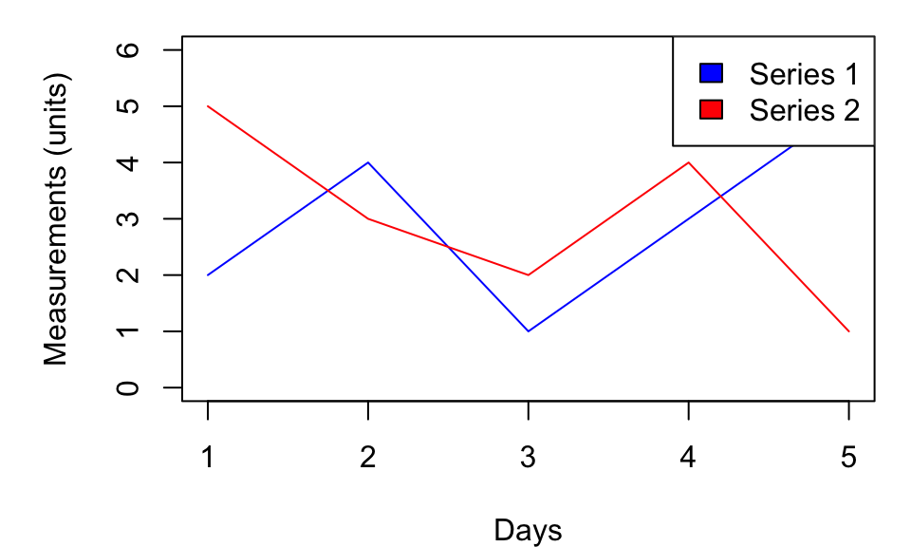
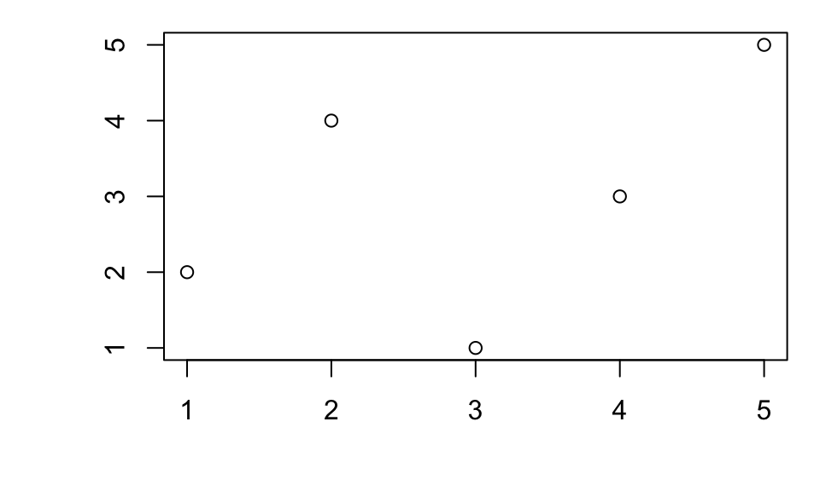
the good, the bad
axis title (with units)
legend
Figure 9.8: Good Plot showing measurements of 2 series over 5 days.
axis values
descriptive caption

Slide 41
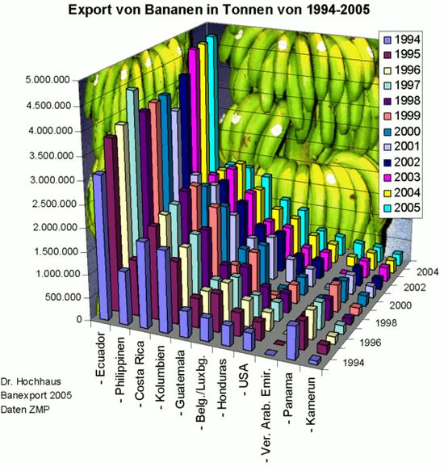
the ugly

Slide 42
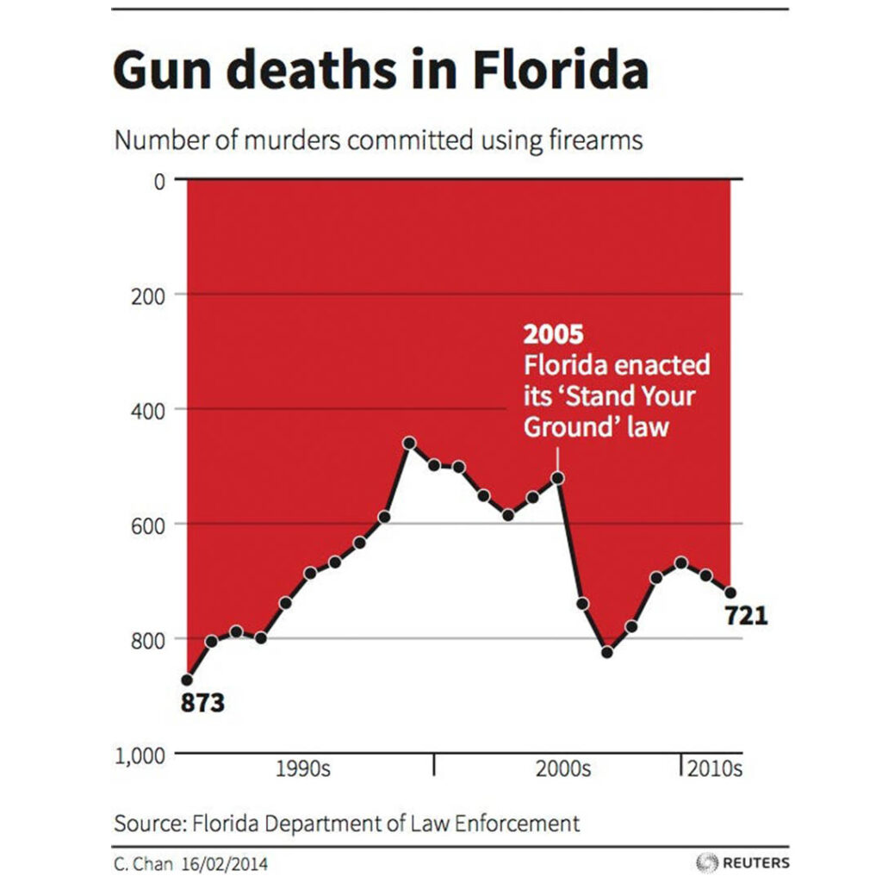
the misleading

Slide 43
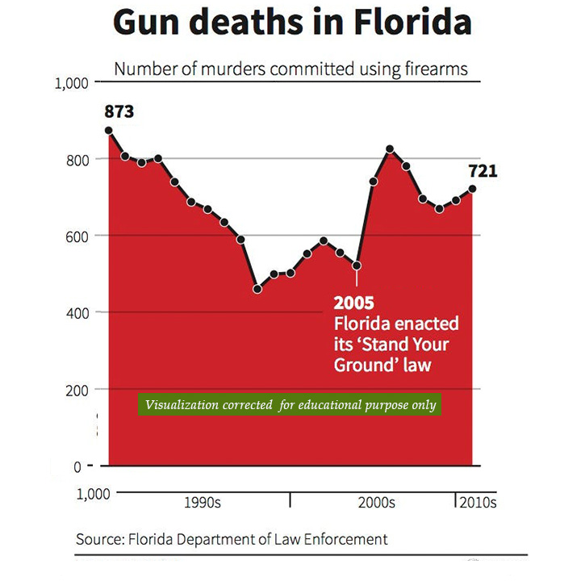
the misleading

Slide 44
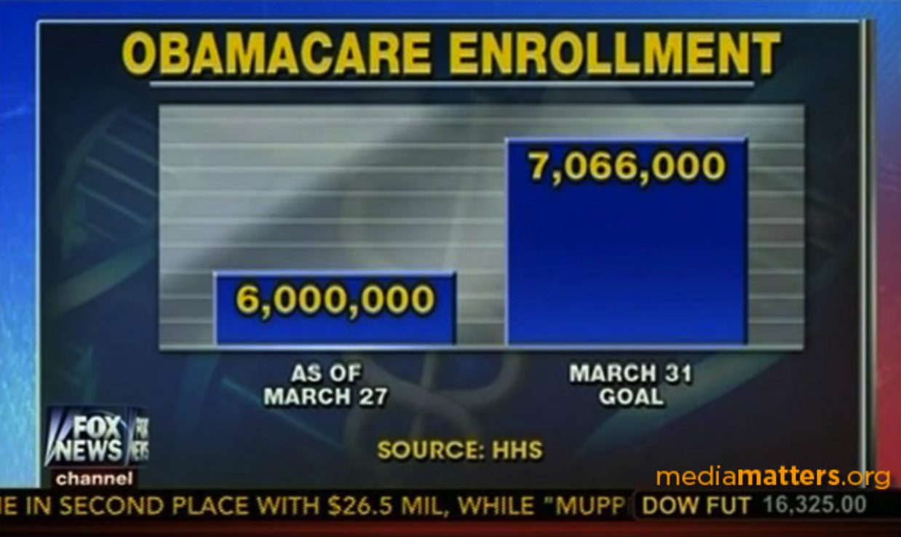

Slide 45
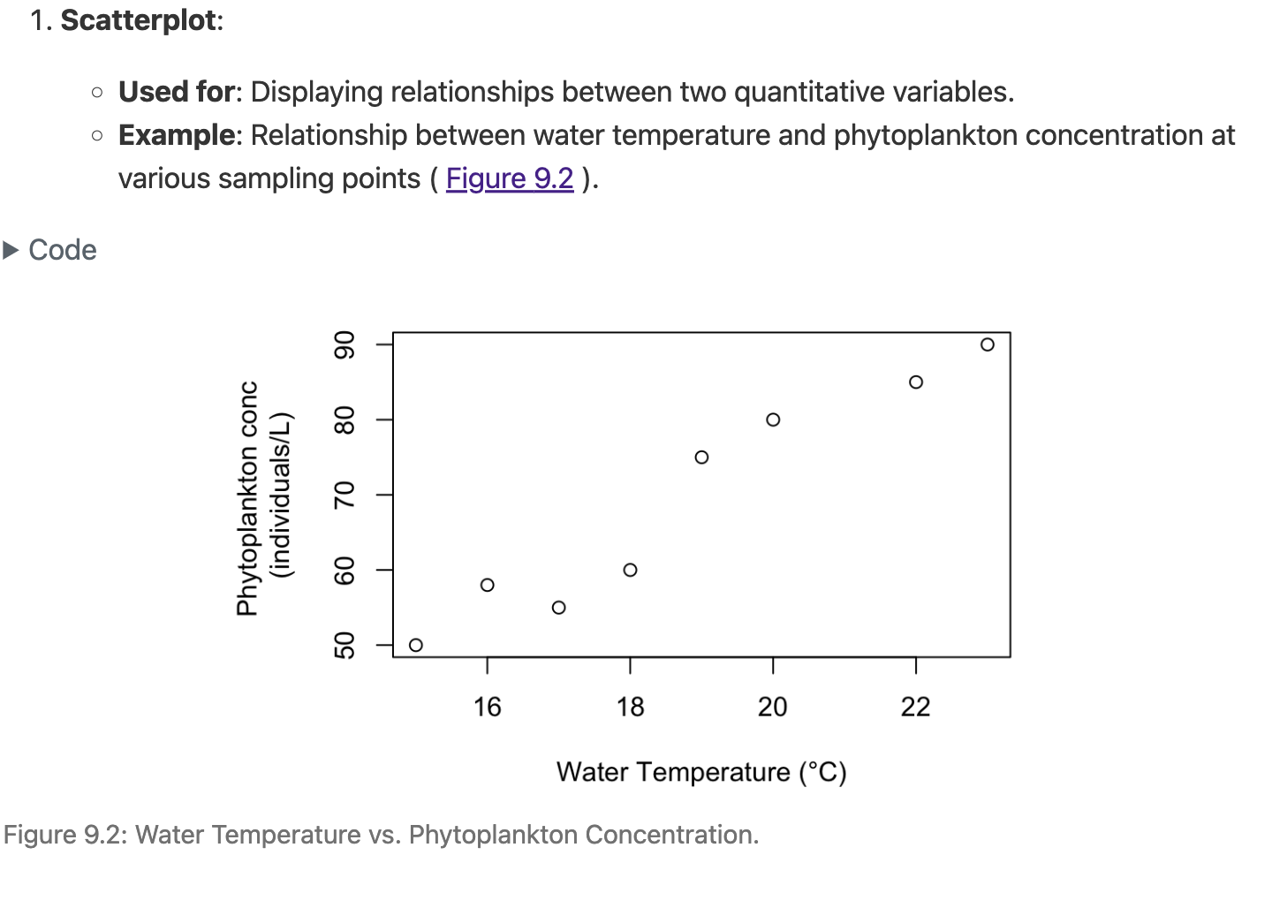
types of plots

Slide 46
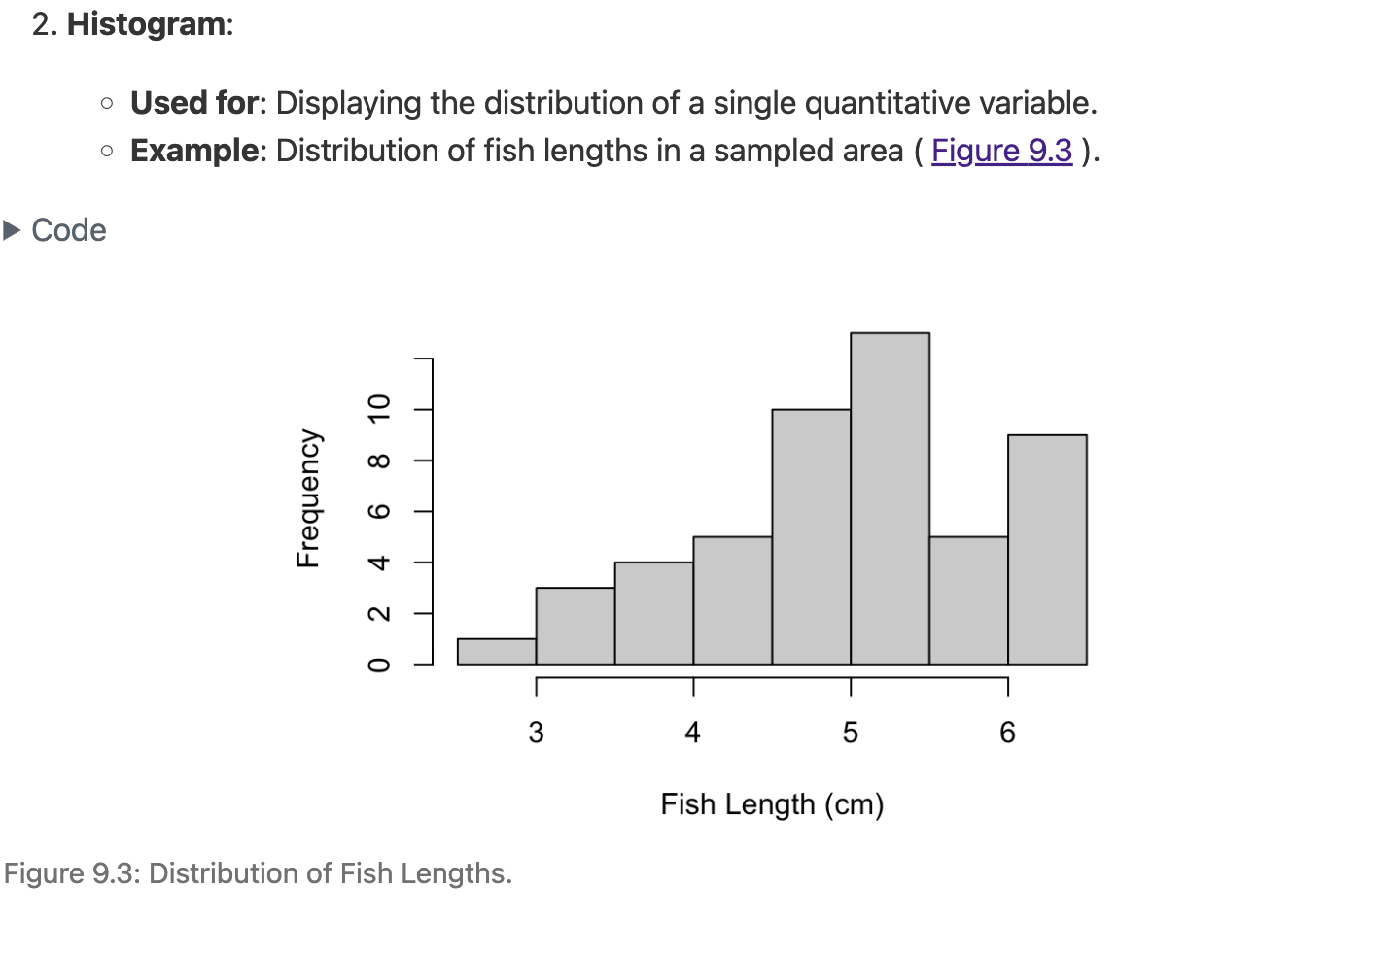
types of plots

Slide 47
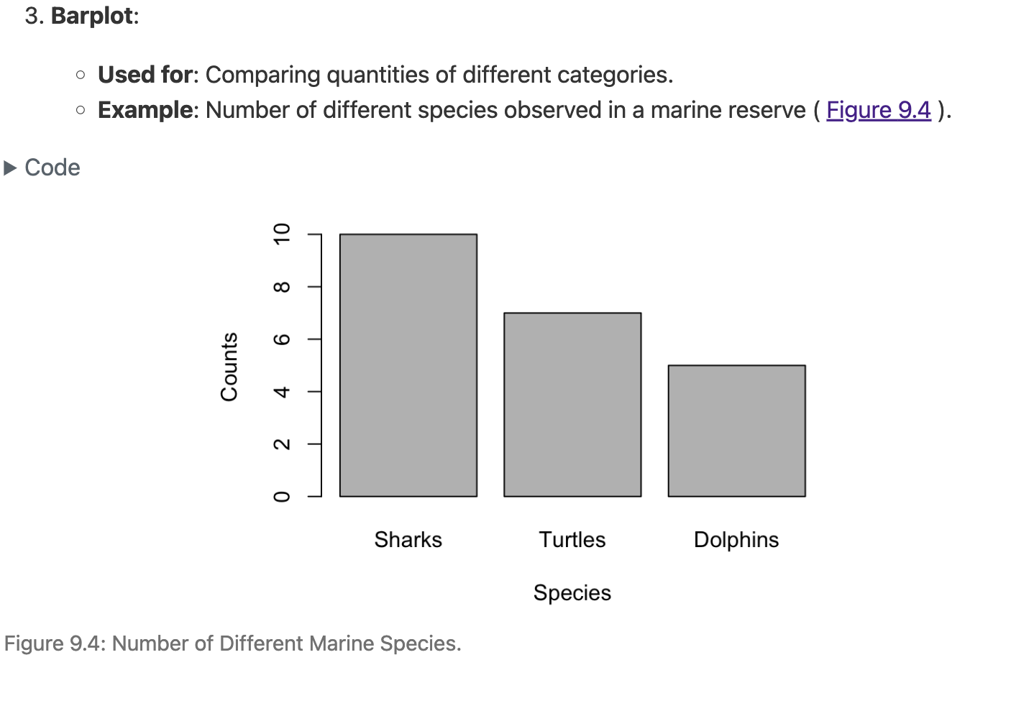
types of plots

Slide 48
types of plots
error bars
mean ± sd
mean ± SEM
You MUST always say which one you are using!

Slide 49
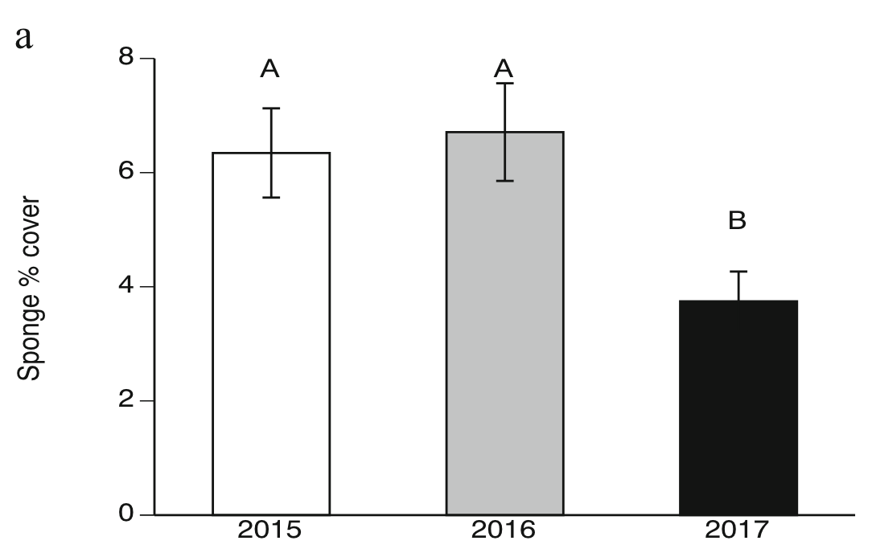
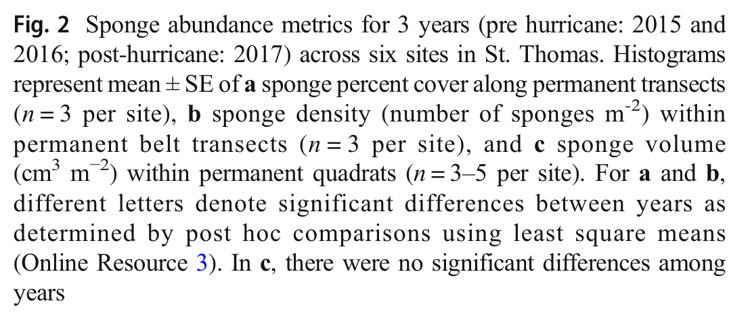
types of plots
error bars
mean ± SEM can help show significant differences between groups.
Gochfeld, D. J. et al. Impacts of Hurricanes Irma and Maria on Coral Reef Sponge Communities in St. Thomas, U.S. Virgin Islands. Estuaries and Coasts (2020) doi:10.1007/s12237-020-00694-4.

Slide 50
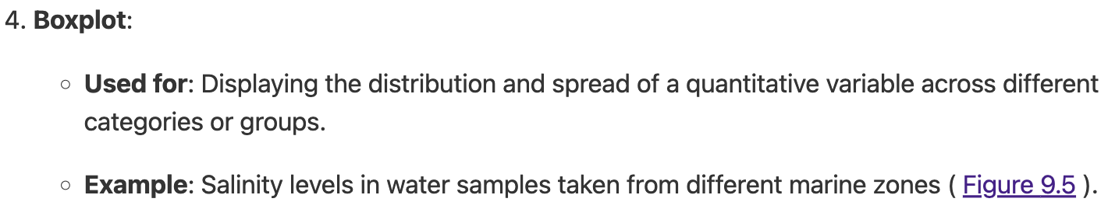
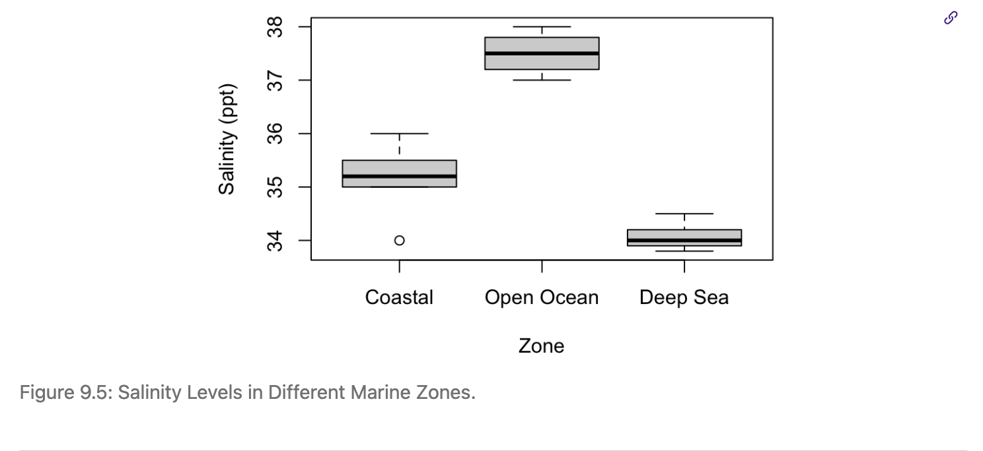
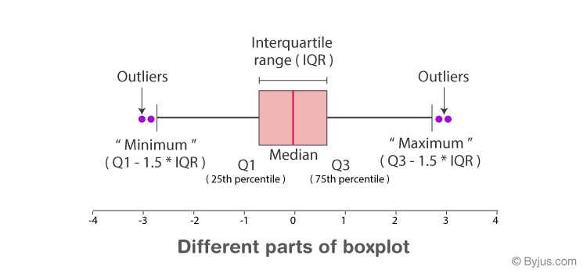
types of plots

Slide 51
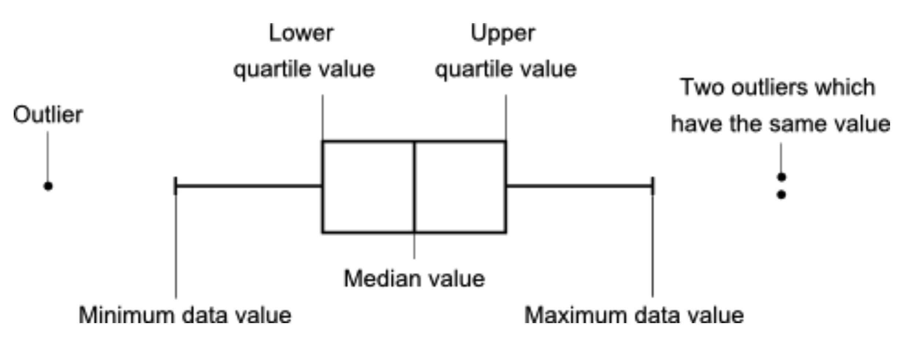
types of plots
Notes:
Box Components:
Box: Represents the interquartile range (IQR).
Lower boundary: First quartile (Q1 or the 25th percentile).
Upper boundary: Third quartile (Q3 or the 75th percentile).
Line inside the box: Median (Q2 or the 50th percentile).
Whiskers: Represent the range for the bulk of the data.
Lower whisker: Extends to the smallest data point within (1.5 \text{IQR}) of Q1.
Upper whisker: Extends to the largest data point within (1.5 \text{IQR}) of Q3.
Outliers: Data points outside the whiskers, usually indicated with dots or other markers.

Slide 52
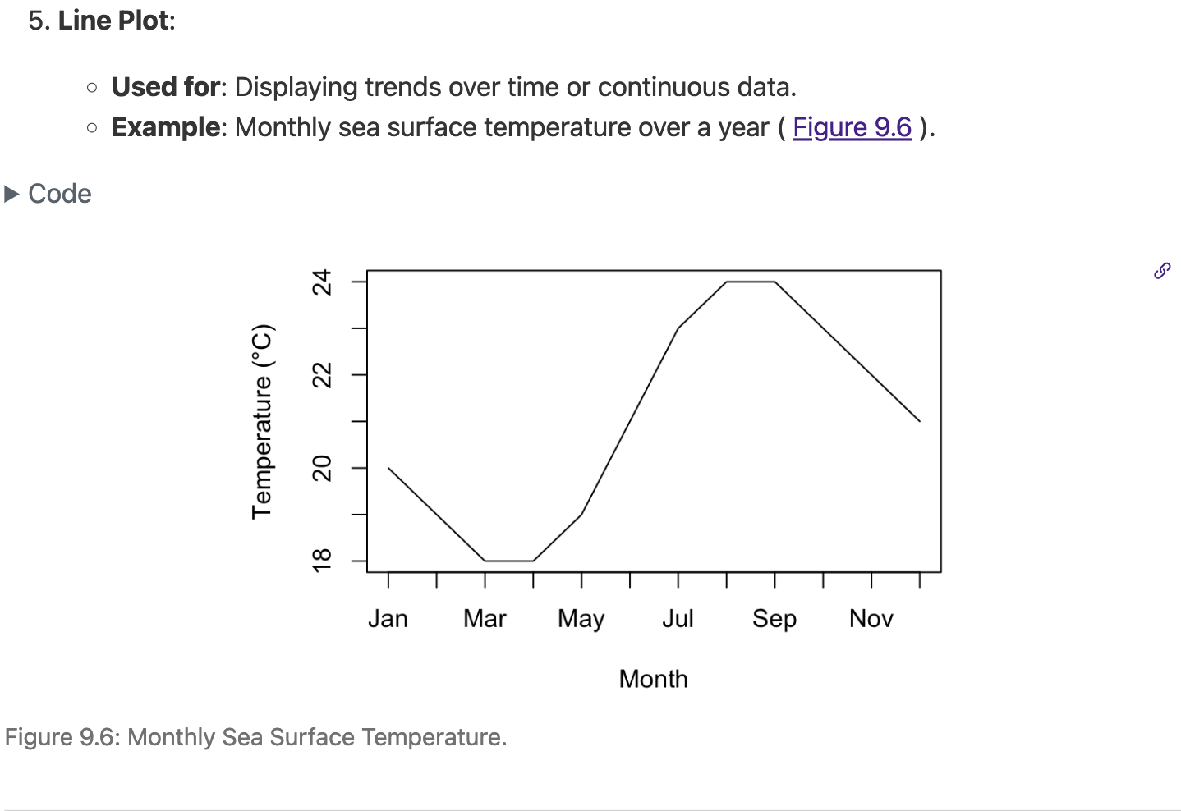
types of plots

